Slide 1

Microsoft identity platform
Developer community call
Microsoft Graph’s advanced capabilities for querying directory objects
Luca Spolidoro
Senior Program Manager
lucaspol@microsoft.com
May 19th, 2022 | 9:00AM PST / 6:00PM CET

Slide 2


Introduction
First things first
Please note: We are recording this call so those unable to attend can benefit from the recording.
This call is designed for developers who implement or are interested in implementing Microsoft identity platform solutions.
What kind of topics will we discuss?
We will address development related topics submitted to us by the community for discussion.
We build a pipeline of topics for the next few weeks, please submit your feedback and topic suggestions - https://aka.ms/IDDevCommunityCallSurvey
View recordings on the Microsoft 365 Developer YouTube channel - https://aka.ms/M365PnP/videos
Follow us on Twitter @Microsoft365Dev and @azuread
This is NOT a support channel. Please use Stack Overflow to ask your immediate support related questions.
When is the next session?
Community Calls: Monthly – 3rd Thursday of every month
Next Identity Developer Community Call: June 16th

Slide 3



Microsoft Graph’s advanced capabilities for querying directory objects
- Luca Spolidoro (Microsoft)
RECORDING
Microsoft Identity dev community call 19th of May
Download recurrent invite from https://aka.ms/IDDevCommunityCalendar

Slide 4

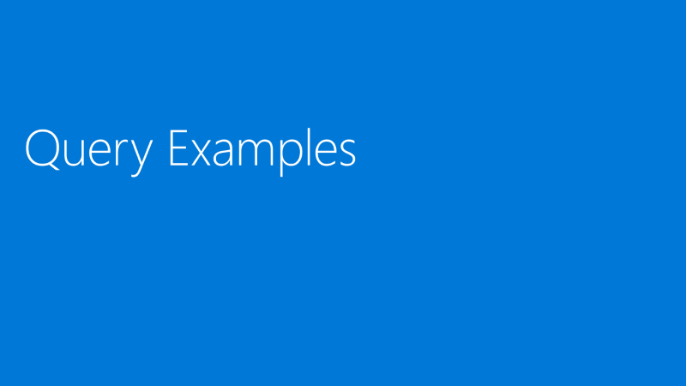
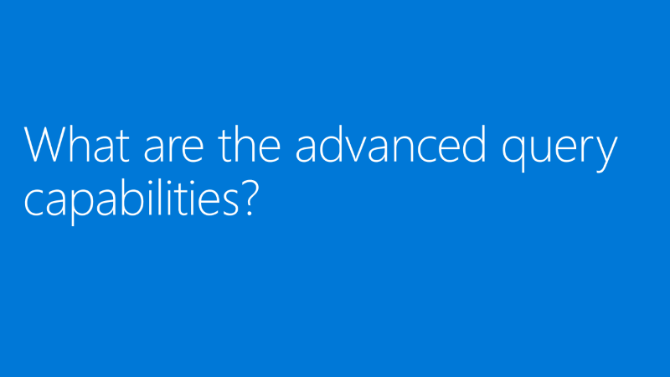






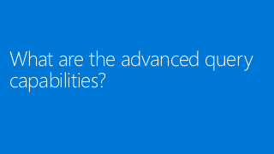
Agenda

Slide 5
What are the advanced query capabilities?

Slide 6
$count, $filter, $search, $orderBy
We added new capabilities to pre-existing Directory Objects and their links
Object | Navigation Properties
Administrative unit | members
Application | owners
Contact | memberOf, transitiveMemberOf
Device | memberOf, transitiveMemberOf, registeredUsers, registeredOwners
Group | members, transitiveMembers, memberOf, transitiveMemberOf, owners, appRoleAssignments
Service principal | memberOf, transitiveMemberOf, appRoleAssignments, appRoleAssignmentsTo, oAuth2PermissionGrant
User | memberOf, transitiveMemberOf, ownedObjects, registeredDevices, ownedDevices, transitiveManagers, directReports, transitiveReports, appRoleAssignments, oAuth2PermissionGrant
oauth2PermissionGrant
transitiveRoleAssignments

Slide 7
What’s your experience with Directory Objects in Microsoft Graph?
Use the chat (pick one):
One or more applications in production using it
Built a proof a concept / test app using it
Never used / never heard of it before
Tried it but I was blocked because… (can you tell us why?)

Slide 8
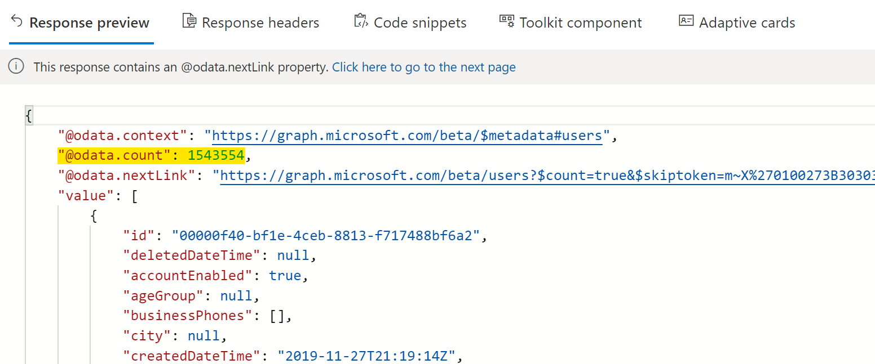
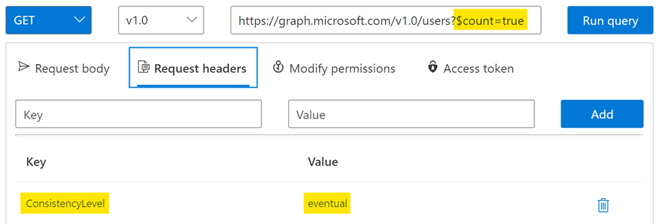
Quick Start
Execute a request using Mezzo Service
Go to Graph Explorer
Add Query string $count=true
Add Request header ConsistencyLevel=eventual
Run the query
Sample Query: GET https://graph.microsoft.com/v1.0/users?$count=true

Slide 9
Under the hood

Slide 10

From Graph to AAD Store
Rest Directory Service (RDS)
AAD Replicas
Microsoft Graph Change Notifications
Microsoft
Graph
Advanced Query Service
Advanced Query Store
Sync Engine

Slide 11

Eventual Consistency

Slide 12



Consistency models in AAD
✅ Highly Available
✅ Highly Resilient
✅ High Performance
✅ Multiple servers (replicas)
EVENTUAL CONSISTENCY
SESSION CONSISTENCY
Write
Read
Read
Directory Replicas

Slide 13

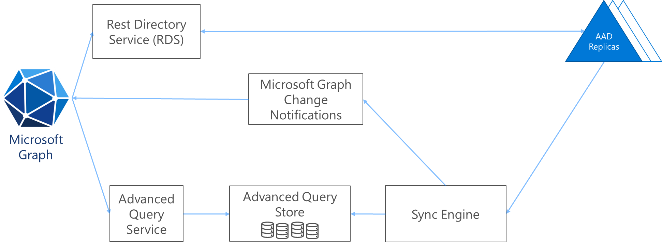


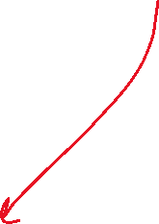

Why the magic parameters?
$count
$search
ConsistencyLevel
eventual

Slide 14
Handling eventual consistency
If | Then
The app is only reading directory data | No issues
The app writes but requires user interaction to read | Use local cache / craft UI to show appropriate messaging
The app writes and automatically reads immediately after | Implement exponential back-off.

Slide 15
Query Examples

Slide 16
Sample Queries – $Count
Count the number of users, groups, applications, contacts, devices, service principals in a tenant, answering questions like:
How many users are in the tenant? GET https://graph.microsoft.com/beta/users/$count
How many guest users are in the tenant, and who are they? GET https://graph.microsoft.com/beta/users/?$count=true&$filter=userType eq ‘Guest’ Note: $count can also be a QueryString parameter, returning the count alongside the result set
How many members are in the engineering group (including transitive and direct members of a group)? GET https://graph.microsoft.com/beta/groups/{group-id}/transitiveMembers/$count Note: A group can contain nested groups, so we are using the transitiveMembers linked property to include all the nested groups’ members.

Slide 17
Sample Queries – $Search (1/2)
Search terms using tokenization
Note: tokenized search is currently limited to displayName and description properties for now.
All the other properties default to the startsWith behavior.
We currently don’t offer true substring searches because it will affect the overall search performance: searching for world will not find helloworld.
Category | Input String | Tokens
Spaces | hello world | hello, world
Different casing | HelloWorld helloWORLD | hello, world
Special characters | hello.world | hello, . , world
Numbers | hello123 | hello, 123
Search for all users in a with “al” in the displayName or with mail starting with “admin”
GET https://graph.microsoft.com/beta/users? $search="displayName:al" OR "mail:admin"

Slide 18
Sample Queries – $Search (2/2)
Search for service principals with “sync” in the displayName GET https://graph.microsoft.com/beta/servicePrincipals? $count=true&$search="displayName:sync"
Search transitively in a group for all members with “ra” or “la” in the displayName GET https://graph.microsoft.com/beta/groups/{group-id}/ transitiveMembers/microsoft.graph.user/? $count=true&$search="displayName:ra" OR "displayName:la"
Note: OData Cast provides a way to trim the results to a specific object type.
Group members can be of the following types: User, Application, servicePrincipal, Device.
In the previous example, specifying /microsoft.graph.user in the URL will return only the users in the group.

Slide 19
Sample Queries – Collection $filter
Get users by proxyAddress ending with “onmicrosoft.com”:
GET https://graph.microsoft.com/beta/users? $count=true& filter=proxyAddresses/any(p:endsWith(p, ‘onmicrosoft.com’))
Note: all filters can be negated with NOT, including Any(…)

Slide 20
Sample Queries – $OrderBy
Sorting can be combined with filter or search
Get last 3 users created that are in building 20:
GET https://graph.microsoft.com/beta/users? $count=true& $orderBy=createddatetime desc&
$filter=startsWith(officelocation, '20’)&
$top=3
Note: $count=true is also required to use $orderBy and $filter together.

Slide 21
Sample Queries – $Batch
GET $batch queries require consistency level headers for each request
"requests": [
{
"id":"1",
"method":"GET",
"url":"/users/$count?$filter=userType eq 'Member'",
"headers":{"ConsistencyLevel":"eventual"}
},
{
"id":"2",
"method":"GET",
"url":"/users/$count?$filter=userType eq 'Guest'",
"headers":{"ConsistencyLevel":"eventual"}
}]

Slide 22
SDK Support

Slide 23
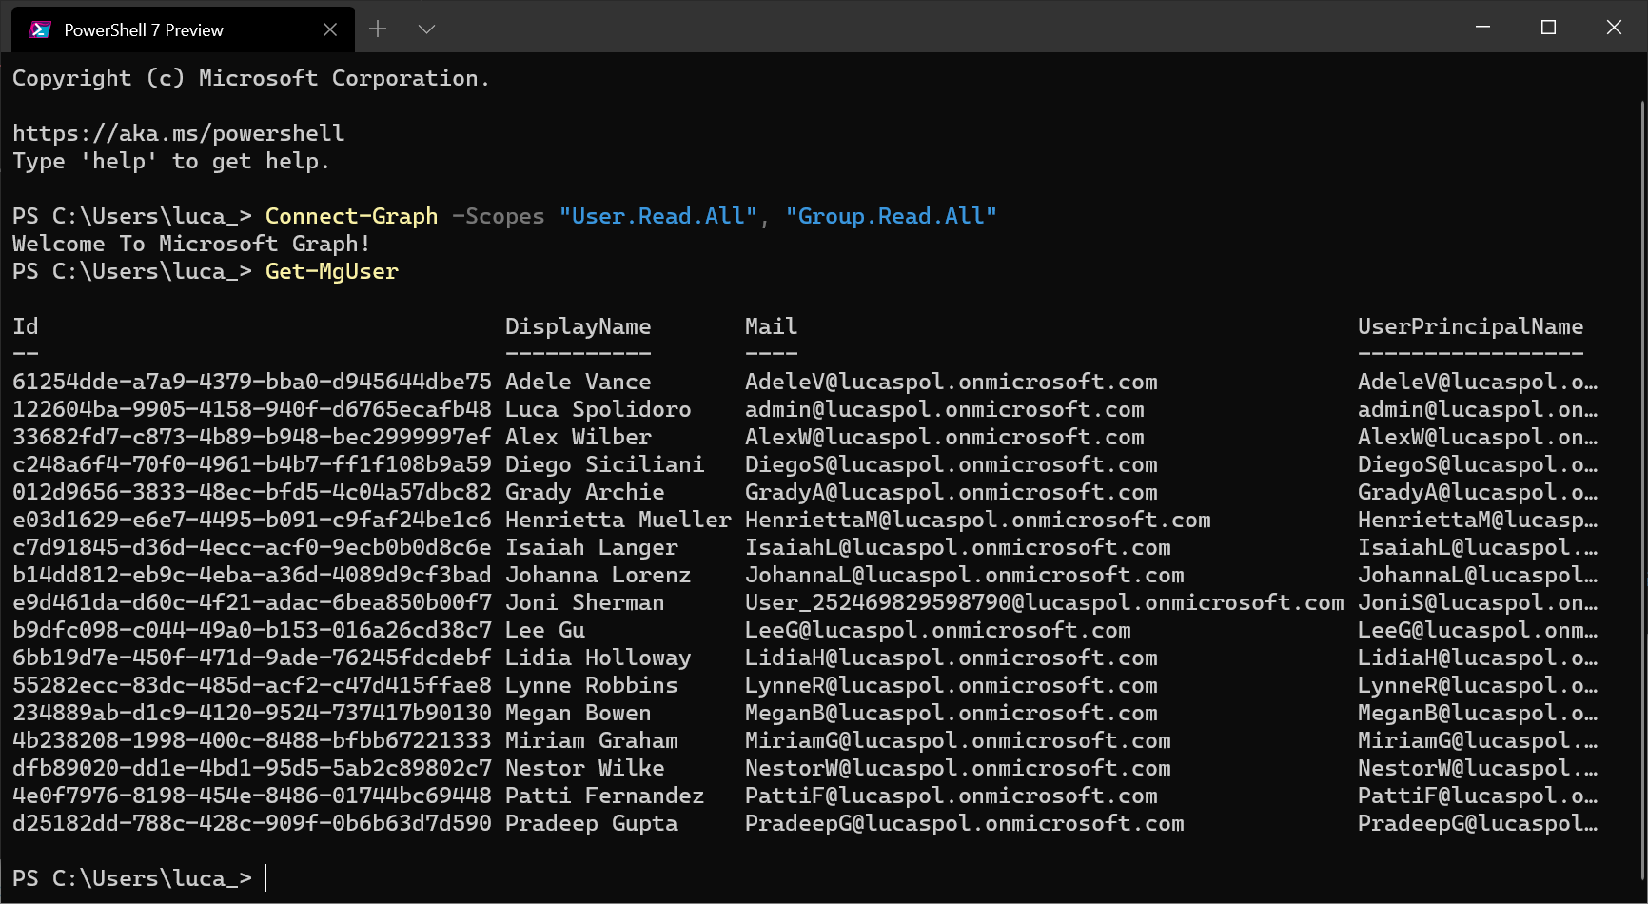
PowerShell support
The Microsoft Graph PowerShell SDK is a collection of PowerShell modules that contain cmdlets for calling Microsoft Graph.

Slide 24
MSGraph PowerShell Quick start
Install Windows Terminal (optional)
Install PowerShell Core
Install-module Microsoft.Graph
Import-Module Microsoft.Graph.Authentication
Import-Module Microsoft.Graph.Users.User
Get-Command -Module Microsoft.Graph*
Connect-Graph -Scopes "User.Read.All"
Get-mgUser -ConsistencyLevel eventual -Count UserCount -Search '"displayName:room"'

Slide 25
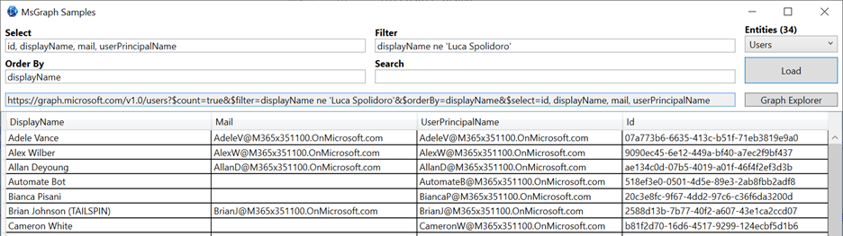
.NET SDK
.NET and other SDKs still need to catch-up, but there are workarounds.
This sample app will show how to.

Slide 26
Conclusion

Slide 27
Current Limitations
All these capabilities are not supported in B2C tenants
$search only limited to displayName and description properties for now, all the other properties default to the startsWith behavior.
endsWith $filter only limited to: mail, otherMails, userPrincipalName and proxyAddresses
No support for $expand (silently failing)
No support for $skip (only $skipToken)
Supports only Eventual Consistency

Slide 28
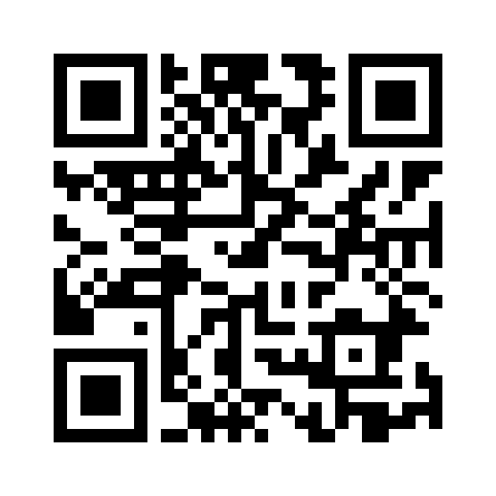
References and Additional Resources
Advanced query capabilities on Azure AD directory objects - Microsoft Graph | Microsoft Docs
https://github.com/microsoftgraph/dotnet-aad-query-sample
To give feedback please fill this survey: https://aka.ms/MsGraphAADSurveyComm

Slide 29
Thank you
Recording will be available soon on the
Microsoft 365 Community (PnP) YouTube channel
https://aka.ms/M365PnP/videos
(subscribe today)
Follow us on Twitter
@Microsoft365Dev and @azuread
Next call: June 16th at 9:00am PT
https://aka.ms/IDDevCommunityCalendar

Slide 30
Q&A

